Slide 1
X-Bow
Pekka Playhouse: Ahmad Sawalha

Slide 2
Clash Royale
A competitive strategy game that focuses on a balance of decks and strategy to counter your opponent.
Each player makes up a deck comprised of 8 cards, including troops, structures, and spells.
The X-bow is currently one of the most commonly used structures for its ability to act as a “win condition”.

Slide 3
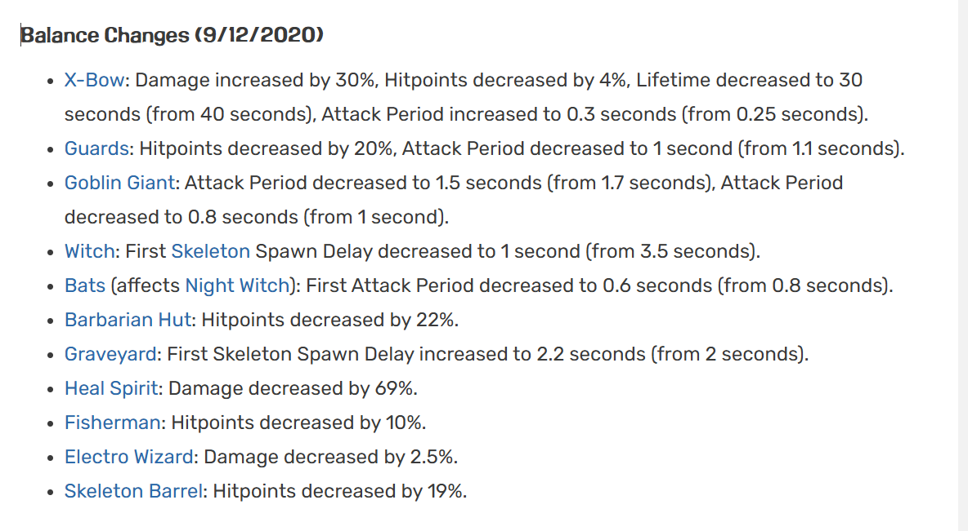
The X-bow was not always as fearful as it is now. Today, we’ll go over the impact of balance changes on the card:
Hey devs, our recent performance update on 9/12/2020 did not go as well as we had planned.
The X-bow, Guards, Graveyard, and Heal Spirit were all nerfed.

Slide 4
Before and After
We divided the first 1 million entries in the dataset into the period before and after the update.
We used the columns indicating the winner and loser card IDs to find patterns due to the effect of the update.

Slide 5
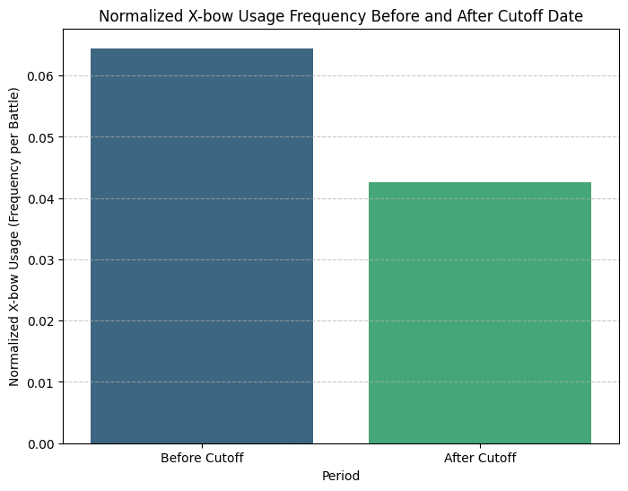
Affects on X-bow
Before: 0.0645
After: 0.0425
Before: 0.5519
After: 0.5100

Slide 6
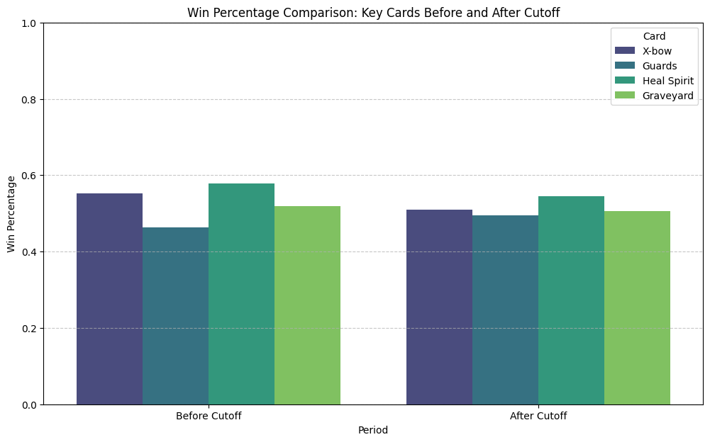

Slide 7
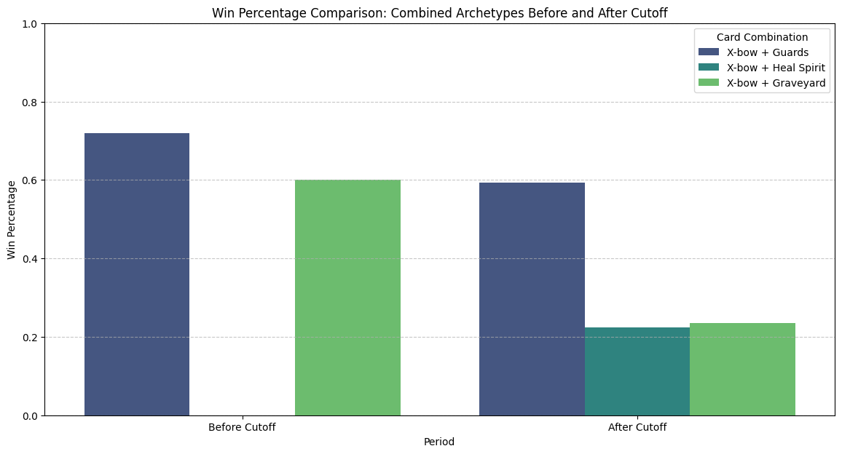
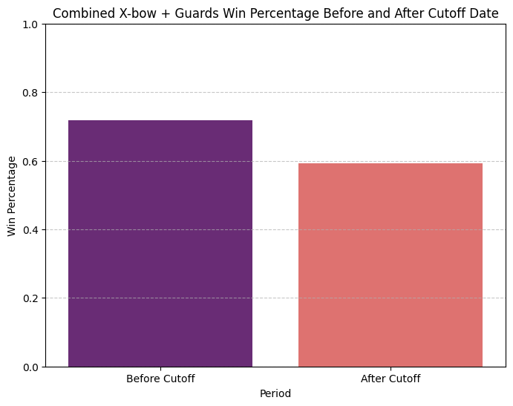
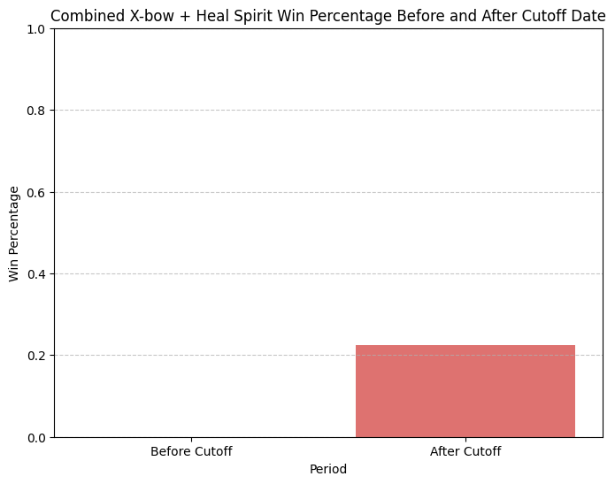
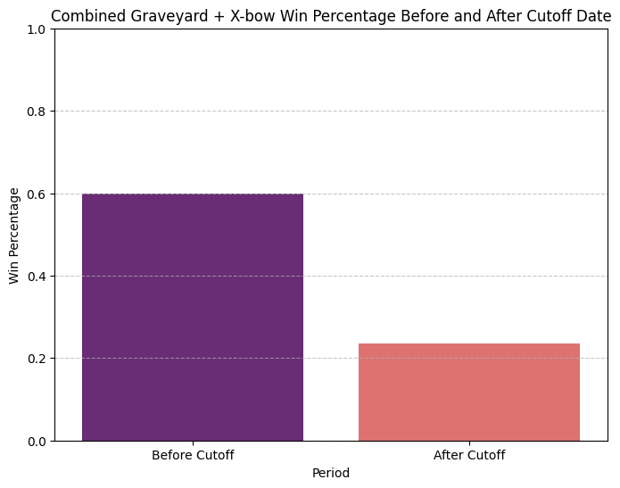
Win Rate Drops

Slide 8
X-bow Archetype generated dataset
Using hot-one encoding, we created a dataset specified for our model with the columns:
- is_winner - totalcard.level - elixir.average
  - startingTrophies - trophyChange - crowns
  ...
  - X-bow + Graveyard - X-bow + Guards - X-bow + Heal Spirit
  - X-bow only - period_before
 | is_winner | totalcard.level | elixir.average | startingTrophies | trophyChange | crowns | troop.count | structure.count | spell.count | common.count | rare.count | epic.count | legendary.count | deck_combo_X-bow + Graveyard | deck_combo_X-bow + Guards | deck_combo_X-bow + Heal Spirit | deck_combo_X-bow-only | period_before
0 | 0 | 77 | 3.00 | 5046.0 | -29.0 | 0.0 | 4 | 2 | 2 | 5 | 1 | 1 | 1 | False | False | False | True | True
1 | 1 | 104 | 3.00 | 7004.0 | 27.0 | 1.0 | 4 | 2 | 2 | 5 | 1 | 1 | 1 | False | False | False | True | True
2 | 0 | 103 | 3.50 | 5634.0 | -30.0 | 0.0 | 3 | 2 | 3 | 4 | 1 | 2 | 1 | False | False | False | True | True
3 | 1 | 104 | 3.00 | 7856.0 | 24.0 | 1.0 | 4 | 2 | 2 | 5 | 1 | 1 | 1 | False | False | False | True | True
4 | 0 | 104 | 3.25 | 7521.0 | -28.0 | 0.0 | 4 | 2 | 2 | 5 | 1 | 1 | 1 | False | False | False | True | True

Slide 9
Logistic Regression Findings
Our model only predicted 55.9% of the data accurately, meaning other predictors are needed for better analysis.
Our model is biased towards class 1, with 78% accuracy in prediction, thus performing much better than on class 0.
Accuracy: 0.5590667119719107
precision recall f1-score support
0 0.57 0.32 0.41 4244
1 0.55 0.78 0.65 4585
accuracy 0.56 8829
macro avg 0.56 0.55 0.53 8829
weighted avg 0.56 0.56 0.53 8829

Slide 10
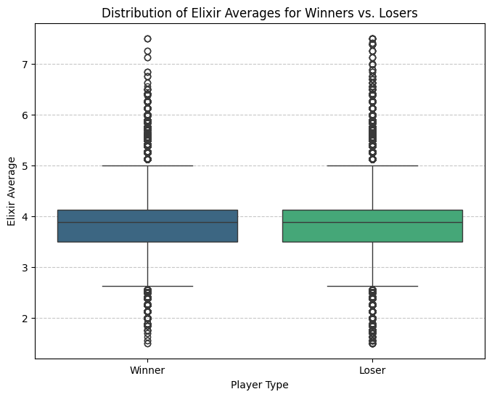
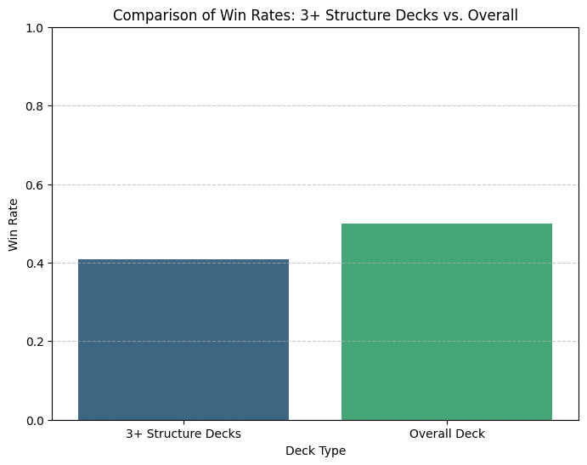
Other factors
Some factors that can help improve the model in accurately predicting the likelihood of winning would be the elixir average and deck makeup (e.g., high structure count)

Slide 11
Logit Regression Results
==============================================================================
Dep. Variable: is_winner No. Observations: 44145
Model: Logit Df Residuals: 44138
Method: MLE Df Model: 6
Date: Fri, 14 Nov 2025 Pseudo R-squ.: 0.01510
Time: 17:44:44 Log-Likelihood: -30119.
converged: False LL-Null: -30580.
Covariance Type: nonrobust LLR p-value: 3.464e-196
=================================================================================
coef std err z P>|z| [0.025 0.975]
--------------------------------------------------------------------------------------------------------------------------------
const -14.4340 1278.911 -0.011 0.991 -2521.054 2492.186
deck_combo_X-bow + Graveyard 15.3401 1278.911 0.012 0.990 -2491.280 2521.960
deck_combo_X-bow + Guards 16.5691 1278.911 0.013 0.990 -2490.051 2523.189
deck_combo_X-bow + Heal Spirit 14.8039 1278.911 0.012 0.991 -2491.816 2521.424
deck_combo_X-bow-only 16.0048 1278.911 0.013 0.990 -2490.615 2522.625
period_before 0.0816 0.031 2.611 0.009 0.020 0.143
elixir.average -0.4336 0.016 -27.962 0.000 -0.464 -0.403
==================================================================================

Slide 12
Interpretation:
Logistic Regression Model, predicting whether a player is a winner based on the deck combo, period, and elixir average. The high p-value for the deck composition means it is not as significant as the elixir average and the period (indicating that the update did in fact affect the results).
The negative coefficient for the period indicates that the update decreased the likelihood of winning for X-bow decks after the update.
Higher elixir average correlates with a lower likelihood of winning.
R-squared is very small, meaning that other variables have a higher correlation with the variation.

Slide 13
Conclusion
Our recent update has rather put X-bow users at a disadvantage instead of balancing the game.

